Slide 1
Introduction to Java
Control Constructs

Slide 2
Selection Statements
if Statements
switch Statements
Conditional Operators

Slide 3
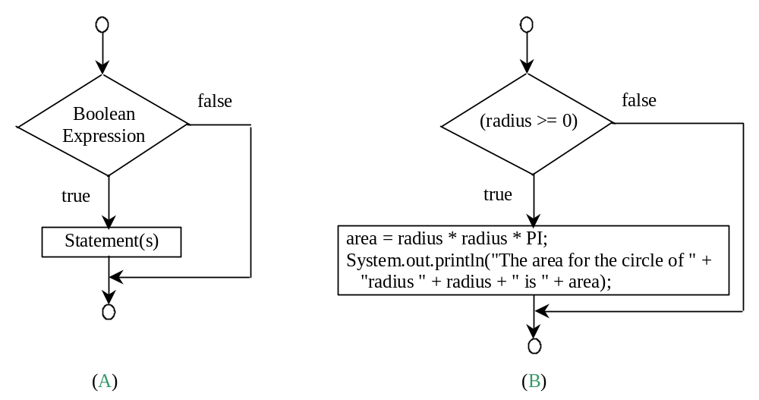
Simple if Statements
if (radius >= 0) {
area = radius * radius * PI;
System.out.println("The area"
+ " for the circle of radius "
+ radius + " is " + area);
}
if (booleanExpression) {
statement(s);
}

Slide 4
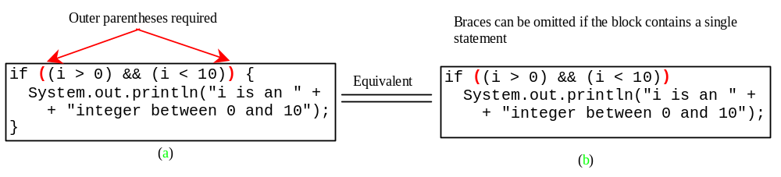
Note

Slide 5
Caution
Adding a semicolon at the end of an if clause is a common mistake.
if (radius >= 0);
{
area = radius*radius*PI;
System.out.println(
"The area for the circle of radius " +
radius + " is " + area);
}
This mistake is hard to find, because it is not a compilation error or a runtime error, it is a logic error.
Wrong

Slide 6
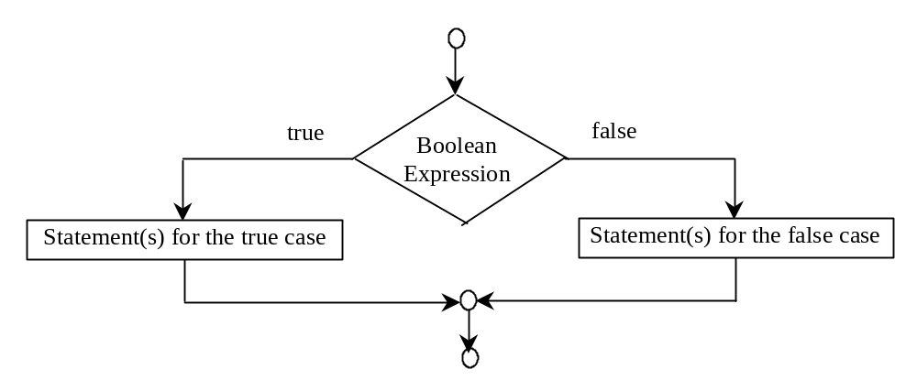
The if...else Statement
if (booleanExpression) {
statement(s)-for-the-true-case;
}
else {
statement(s)-for-the-false-case;
}

Slide 7
if...else Example
if (radius >= 0) {
area = radius * radius * 3.14159;
System.out.println("The area for the “
+ “circle of radius " + radius +
" is " + area);
}
else {
System.out.println("Negative input");
}

Slide 8
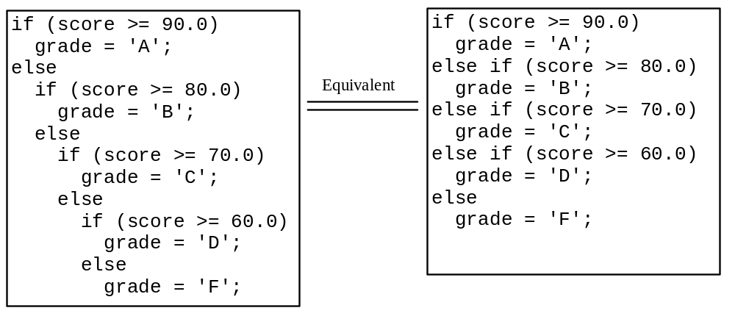
Multiple Alternative if Statements

Slide 9
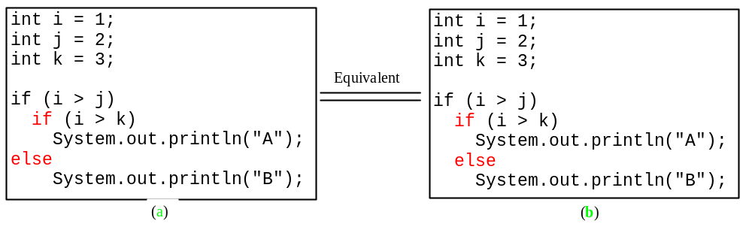
Note
The else clause matches the most recent if clause in the same block.

Slide 10
Note, cont.
Nothing is printed from the preceding statement. To force the else clause to match the first if clause, you must add a pair of braces:
int i = 1;
int j = 2;
int k = 3;
if (i > j) {
if (i > k)
System.out.println("A");
}
else
System.out.println("B");
What does this statement print?
B

Slide 11

TIP

Slide 12

CAUTION

Slide 13
An Improved Math Learning Tool - Example
Creates a program to teach a first grade child how to learn subtractions.
The program randomly generates two single-digit integers number1 and number2 with number1 > number2 and displays a question such as “What is 9 – 2?” to the student.
After the student types the answer in the input dialog box, the program displays a message dialog box to indicate whether the answer is correct.

Slide 14
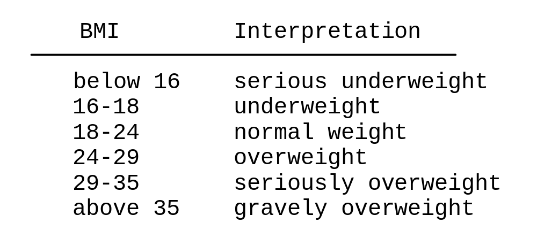
Body Mass Index – Example
Body Mass Index (BMI) is a measure of health on weight. It can be calculated by taking your weight in kilograms and dividing by the square of your height in meters. The interpretation of BMI for people 16 years or older is as follows:

Slide 15
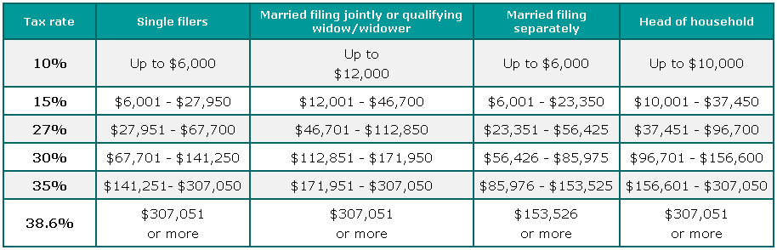
Computing Taxes – Example
The US federal personal income tax is calculated based on the filing status and taxable income. There are four filing statuses: single filers, married filing jointly, married filing separately, and head of household. The tax rates for are shown in table below.

Slide 16
Problem: Computing Taxes, cont.
if (status == 0) {
// Compute tax for single filers
}
else if (status == 1) {
// Compute tax for married file jointly
}
else if (status == 2) {
// Compute tax for married file separately
}
else if (status == 3) {
// Compute tax for head of household
}
else {
// Display wrong status
}

Slide 17
switch Statements
switch (status) {
case 0: compute taxes for single filers;
break;
case 1: compute taxes for married file jointly;
break;
case 2: compute taxes for married file separately;
break;
case 3: compute taxes for head of household;
break;
default: System.out.println("Errors: invalid status");
System.exit(0);
}

Slide 18
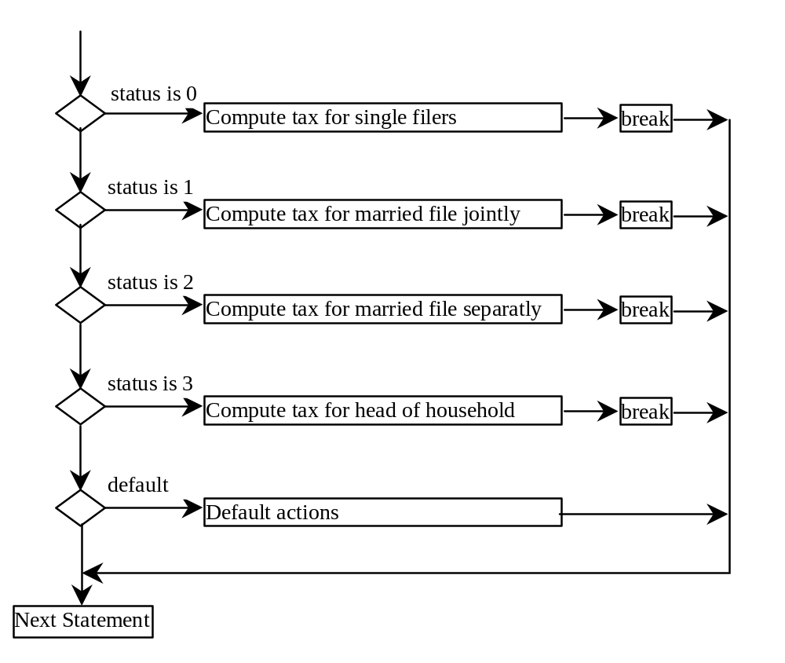
switch Statement Flow Chart

Slide 19
switch Statement Rules
The switch-expression must yield a value of char, byte, short, or int type and must always be enclosed in parentheses.
switch (switch-expression) {
case value1: statement(s)1;
break;
case value2: statement(s)2;
break;
…
case valueN: statement(s)N;
break;
default: statement(s)-for-default;
}
The value1, ..., and valueN must have the same data type as the value of the switch-expression. The resulting statements in the case statement are executed when the value in the case statement matches the value of the switch-expression. Note that value1, ..., and valueN are constant expressions, meaning that they cannot contain variables in the expression, such as 1 + x.

Slide 20
switch Statement Rules
The keyword break is optional, but it should be used at the end of each case in order to terminate the remainder of the switch statement. If the break statement is not present, the next case statement will be executed.
switch (switch-expression) {
case value1: statement(s)1;
break;
case value2: statement(s)2;
break;
…
case valueN: statement(s)N;
break;
default: statement(s)-for-default;
}
The default case, which is optional, can be used to perform actions when none of the specified cases matches the switch-expression.
The case statements are executed in sequential order, but the order of the cases (including the default case) does not matter. However, it is good programming style to follow the logical sequence of the cases and place the default case at the end.

Slide 21
Conditional Operator
if (x > 0)
y = 1
else
y = -1;
is equivalent to
y = (x > 0) ? 1 : -1;
(booleanExpression) ? expression1 : expression2

Slide 22
Conditional Operator
if (num % 2 == 0)
System.out.println(num + “is even”);
else
System.out.println(num + “is odd”);
System.out.println(
(num % 2 == 0)? num + “is even” :
num + “is odd”);

Slide 23
Conditional Operator, cont.
(booleanExp) ? exp1 : exp2

Slide 24
Formatting Output
Use the JDK 1.5 or later printf statement.
  System.out.printf(format, items);
Where format is a string that may consist of substrings and format specifiers. A format specifier specifies how an item should be displayed. An item may be a numeric value, character, boolean value, or a string. Each specifier begins with a percent sign.

Slide 25

Frequently-Used Specifiers
Specifier Output Example
%b a boolean value true or false
%c a character 'a'
%d a decimal integer 200
%f a floating-point number 45.460000
%e a number in standard scientific notation 4.556000e+01
%s a string "Java is cool"

Slide 26
Operator Precedence
var++, var--
++var, --var
(type) Casting
! (Not)
*, /, % (Multiplication, division, and remainder)
+, - (Binary addition and subtraction)
<, <=, >, >= (Comparison)
==, !=; (Equality)
^ (Exclusive OR)
&& (Conditional AND) Short-circuit AND
|| (Conditional OR) Short-circuit OR
=, +=, -=, *=, /=, %= (Assignment operator)

Slide 27
Operator Precedence and Associativity
The expression in the parentheses is evaluated first. (Parentheses can be nested, in which case the expression in the inner parentheses is executed first.) When evaluating an expression without parentheses, the operators are applied according to the precedence rule and the associativity rule.
If operators with the same precedence are next to each other, their associativity determines the order of evaluation. All binary operators except assignment operators are left-associative.

Slide 28
Operator Associativity
When two operators with the same precedence are evaluated, the associativity of the operators determines the order of evaluation. All binary operators except assignment operators are left-associative.
a – b + c – d is equivalent to ((a – b) + c) – d
Assignment operators are right-associative. Therefore, the expression
a = b += c = 5 is equivalent to a = (b += (c = 5))

Slide 29
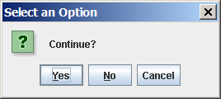
(GUI) Confirmation Dialogs
int option = JOptionPane.showConfirmDialog
(null, "Continue");
Return values: 0 (Yes), 1 (No), 2 (Cancel)

Slide 30
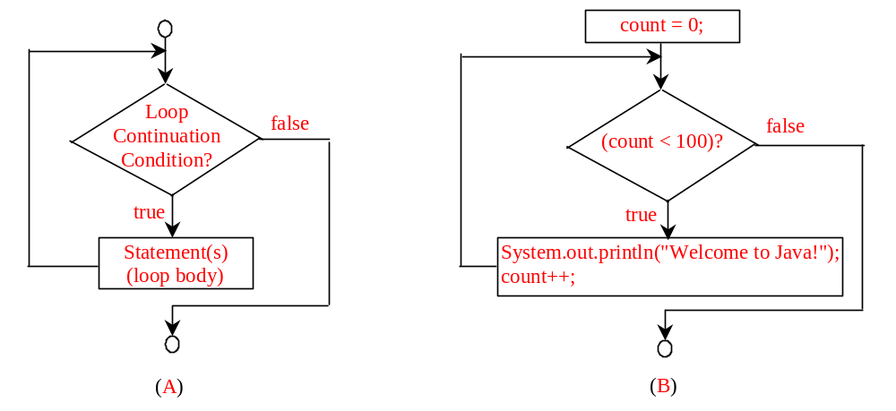
while Loop Flow Chart
int count = 0;
while (count < 100) {
System.out.println("Welcome to Java!");
count++;
}
while (loop-continuation-condition) {
// loop-body;
Statement(s);
}

Slide 31
Ending a Loop with a Sentinel Value
Often the number of times a loop is executed is not predetermined. You may use an input value to signify the end of the loop. Such a value is known as a sentinel value.
Example 4: Write a program that reads and calculates the sum of an unspecified number of integers. The input 0 signifies the end of the input.

Slide 32
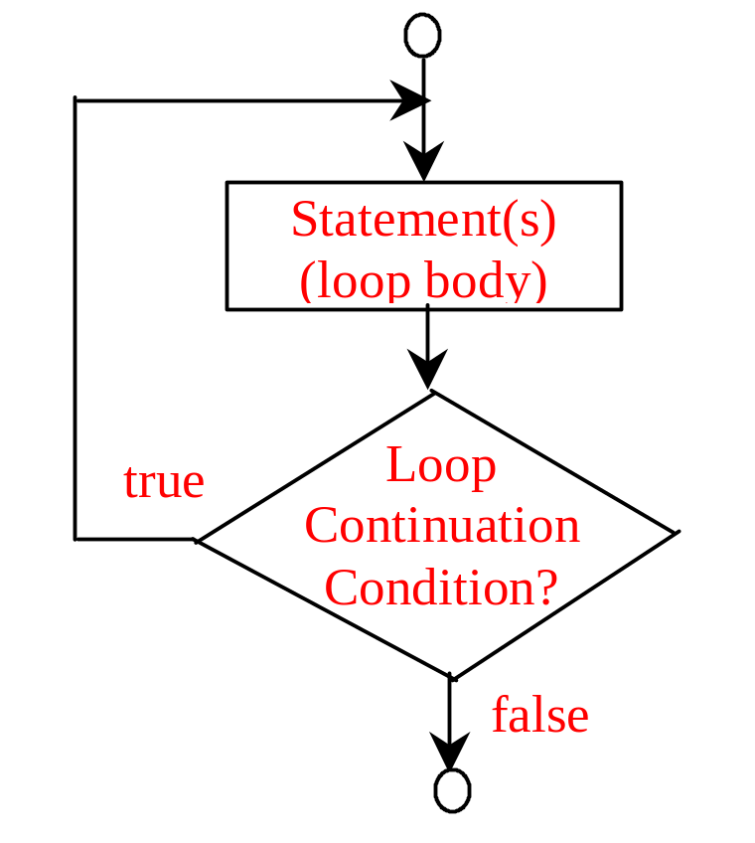
do-while Loop
do {
// Loop body;
Statement(s);
} while (loop-continuation-condition);

Slide 33
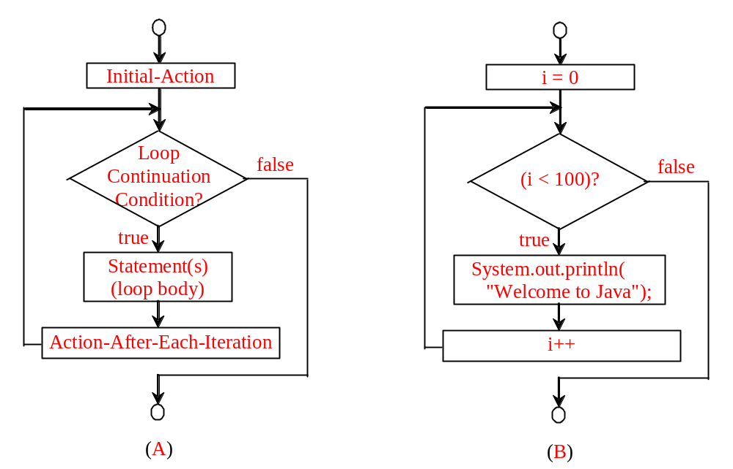
for Loops
for (initial-action; loop-continuation-condition; action-after-each-iteration) {
// loop body;
Statement(s);
}
int i;
for (i = 0; i < 100; i++) {
System.out.println(
"Welcome to Java!");
}

Slide 34
Note
The initial-action in a for loop can be a list of zero or more comma-separated expressions. The action-after-each-iteration in a for loop can be a list of zero or more comma-separated statements. Therefore, the following two for loops are correct. They are rarely used in practice, however.
  for (int i = 1; i < 100; System.out.println(i++));
  for (int i = 0, j = 0; (i + j < 10); i++, j++) {
  // Do something
  }

Slide 35

Note
If the loop-continuation-condition in a for loop is omitted, it is implicitly true. Thus the statement given below in (a), which is an infinite loop, is correct. Nevertheless, it is better to use the equivalent loop in (b) to avoid confusion:

Slide 36
Caution
Adding a semicolon at the end of the for clause before the loop body is a common mistake, as shown below:
Logic Error
for (int i=0; i<10; i++);
{
System.out.println("i is " + i);
}

Slide 37
Caution, cont.
Similarly, the following loop is also wrong:
int i=0;
while (i < 10);
{
System.out.println("i is " + i);
i++;
}
In the case of the do loop, the following semicolon is needed to end the loop.
int i=0;
do {
System.out.println("i is " + i);
i++;
} while (i<10);
Logic Error
Correct

Slide 38


Which Loop to Use?
The three forms of loop statements, while, do-while, and for, are expressively equivalent; that is, you can write a loop in any of these three forms. For example, a while loop in (a) in the following figure can always be converted into the following for loop in (b):
A for loop in (a) in the following figure can generally be converted into the following while loop in (b):

Slide 39
Recommendations
Use the one that is most intuitive and comfortable for you. In general:
a for loop may be used if the number of repetitions is known, as, for example, when you need to print a message 100 times.
a while loop may be used if the number of repetitions is not known, as in the case of reading the numbers until the input is 0.
a do-while loop can be used to replace a while loop if the loop body has to be executed before testing the continuation condition.

Slide 40
(GUI) Controlling a Loop with a Confirmation Dialog
A sentinel-controlled loop can be implemented using a confirmation dialog. The answers Yes or No to continue or terminate the loop. The template of the loop may look as follows:
int option = 0;
while (option == JOptionPane.YES_OPTION) {
System.out.println("continue loop");
option = JOptionPane.showConfirmDialog(null, "Continue?");
}

